Slide 1


Rhys Morton T1A3 Terminal App
Booking System

Slide 2

Restaurant booking system
A terminal app, designed for use by restaurant staff to input customer bookings with details, getting stored locally.
This app is built with the following features
Add booking, with customer details, time and amount of people
View bookings for each service (breakfast, lunch, dinner or all)
Search and edit bookings

Slide 3
Coding style
Application is quite modular, using only functions with the exception of the home page.
Large use of ‘while True’ loops, to control error checking in menu selection.
‘user_input’ is frequently used a variabele for inputs in each function, understanding how scope works.
Mixture of if statements and switch cases used. Switch is used for menus as it looks cleaner.

Slide 4
Imported libraries/modules used
Time is imported for the use of the sleep function. This is used widely across the application to allow the user to read messages before moving to the next.
Os is imported for ‘os.system(‘clear’), which clears the window. This is used in transitions between messages to keep the application looking clean.
Random is imported for ‘randint’ to generate the random phone number
Re is imported for ‘findall’, used in the search function to match the input to the line in the text file.

Slide 5
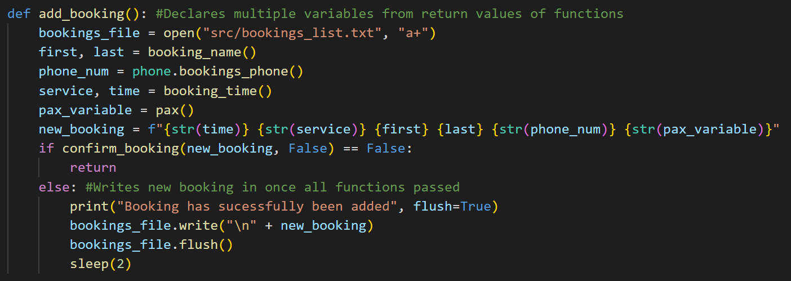
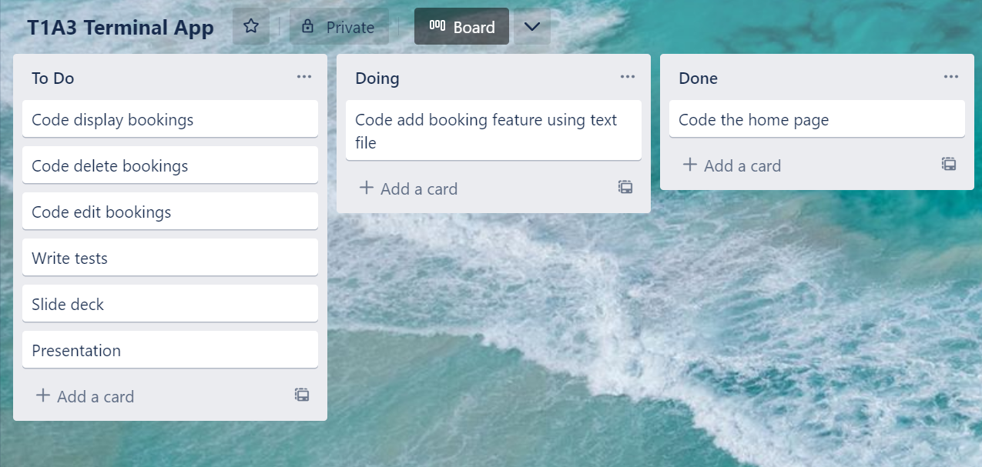
Add booking feature
From the home page this function is called. Nice and simple, calling the functions for each customer detail required and saving their return values to variables.
At the end, all the variables are combined into one and written into the text file

Slide 6
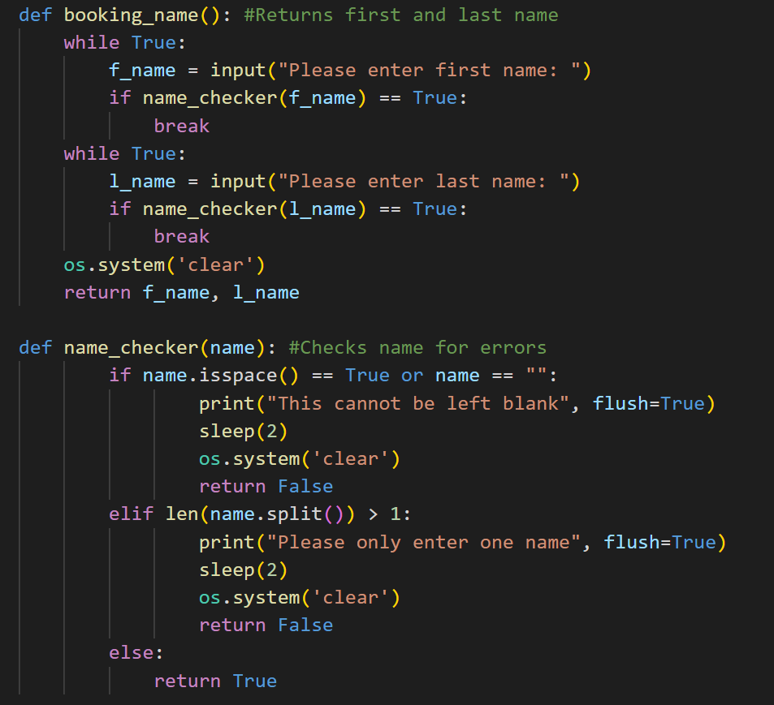
Booking name
‘booking_name()’ just asks the user to input the customer name, using ‘name_checker()’ for error checking, ensuring that the user can’t leave it blank

Slide 7
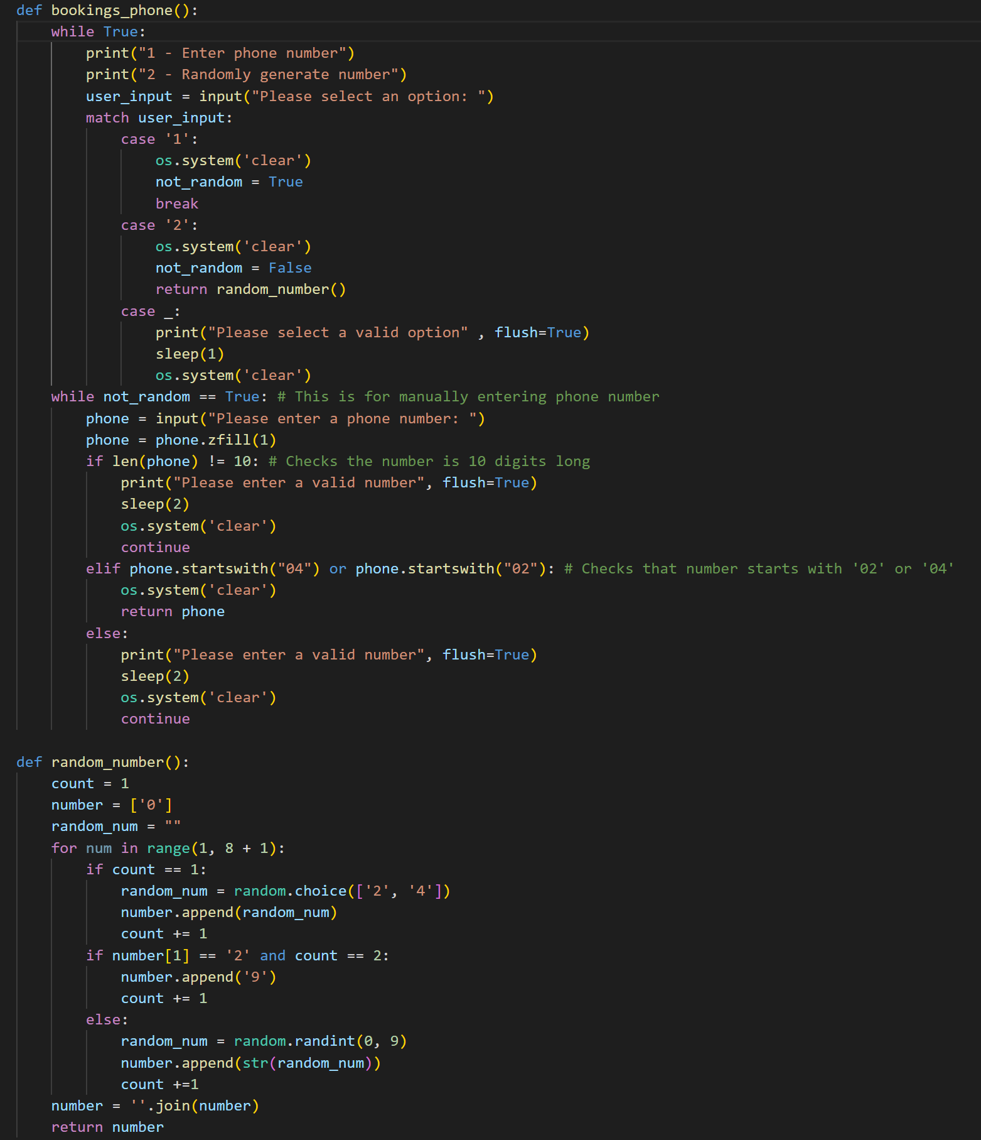
Phone number
‘bookings_phone()’ function is used to store a phone number. An option is available to randomly generate one.
Error checking is used to ensure that a valid number is input.
Mobile – starting with ‘04’
Home – starting with ’02’

Slide 8
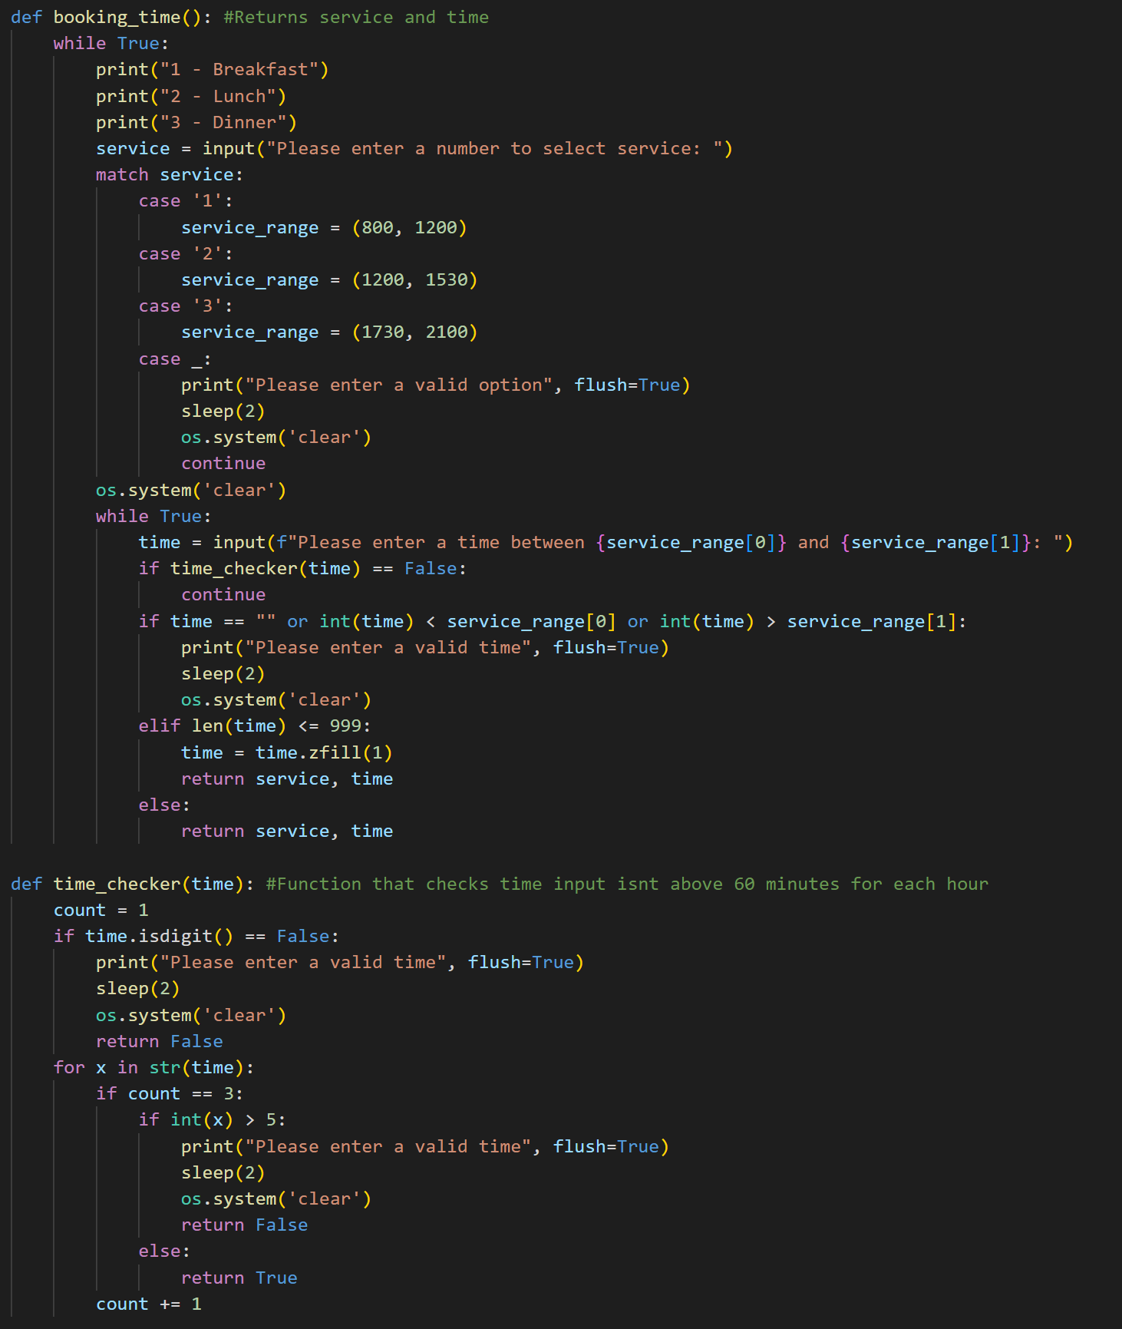
Booking time
‘booking_time()’ asks the user to input a service and then a corresponding time, using 24hour time.
‘time_checker()’ ensures that the user can’t enter a time in minutes above 60.

Slide 9
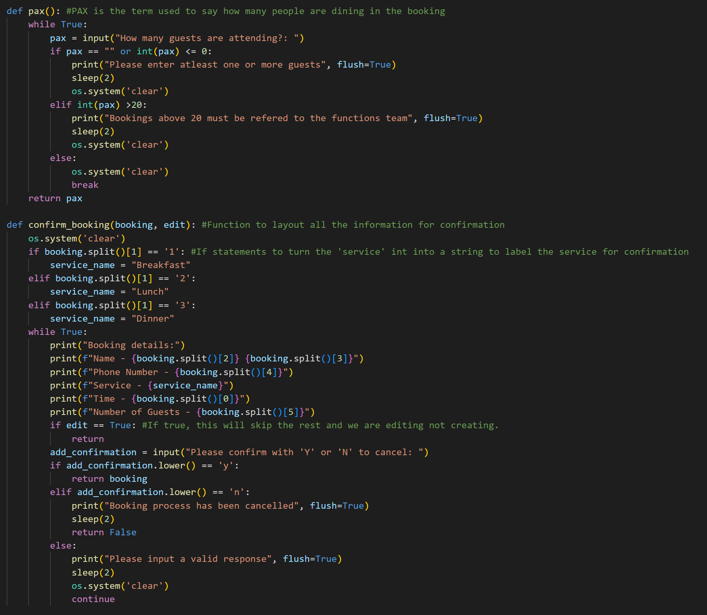
Booking pax and confirm
Pax (amount of people attending) is saved through ‘pax()’, with some error checking.
‘confirm_booking()’ takes all of the details combined and prints it all out for the user to see to confirm before being written to the text file.

Slide 10
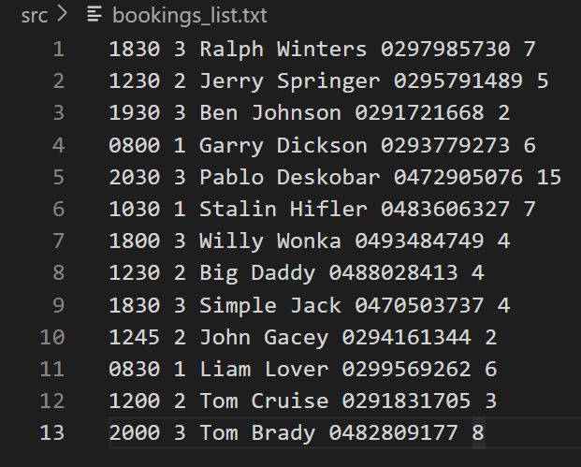
Bookings.txt
When confirmed, this is what gets written to the text file in this specific order.
Booking time
Service number
First name
Last name
Phone number
Pax

Slide 11
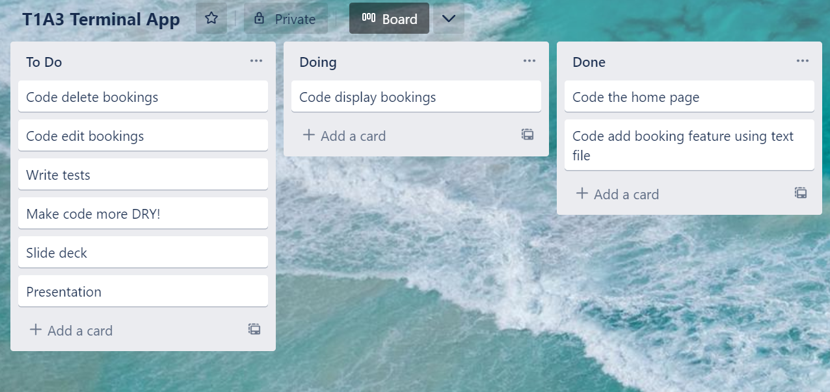
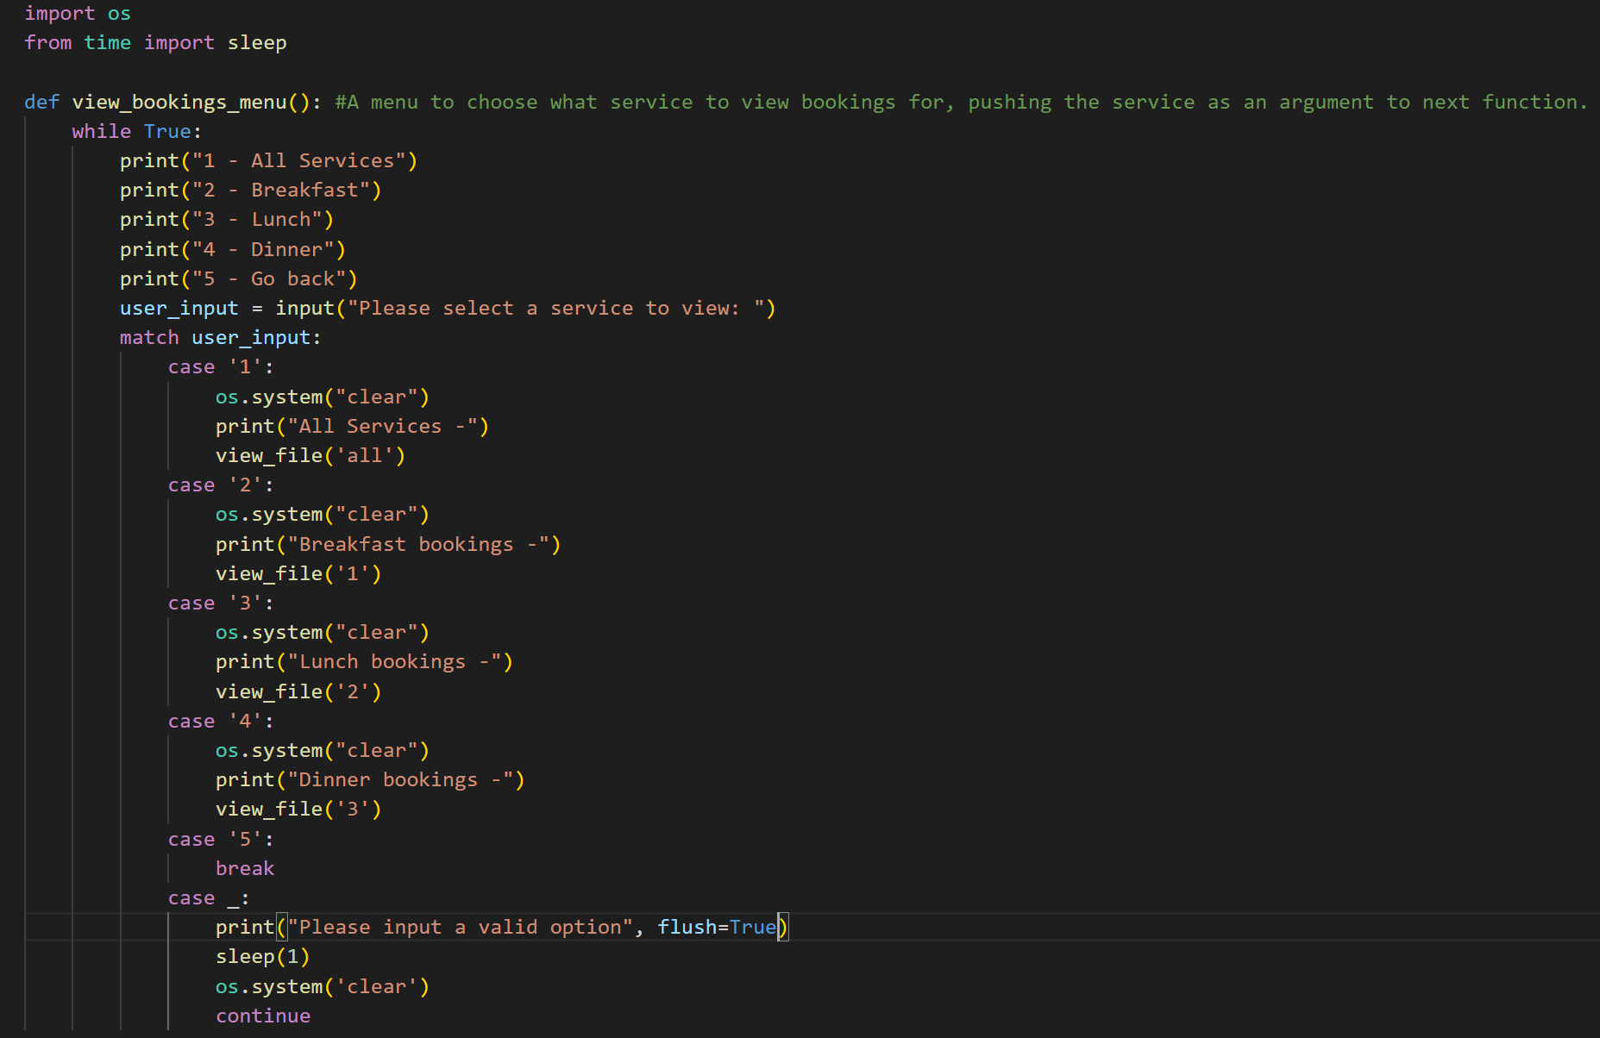
View bookings feature
From home page, user gets navigated to ‘view_bookings_menu()’ where a choice of which service the user wants to view is made.

Slide 12
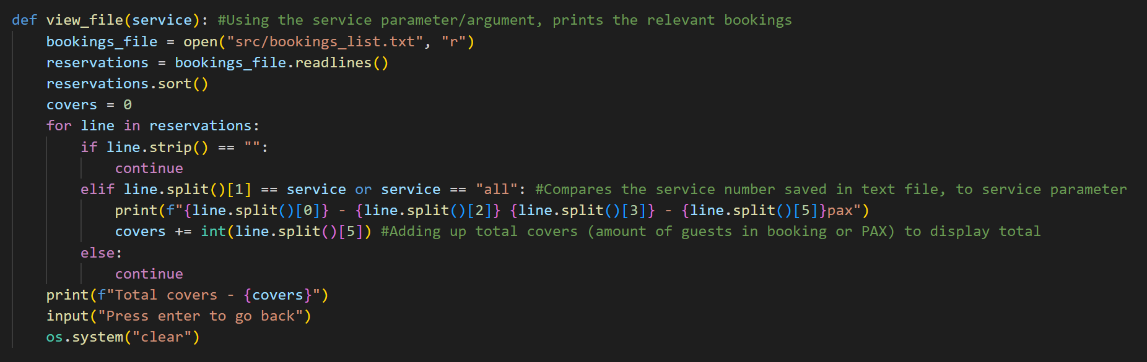
View bookings
‘view_file()’ is a DRY function that displays all the bookings in the requested service using an argument.
The function iterates through each line in bookings.txt and prints those that match the requirements.

Slide 13
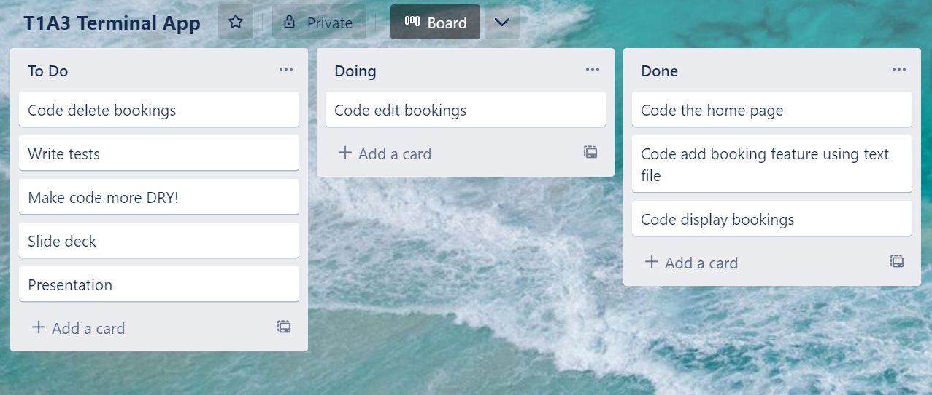
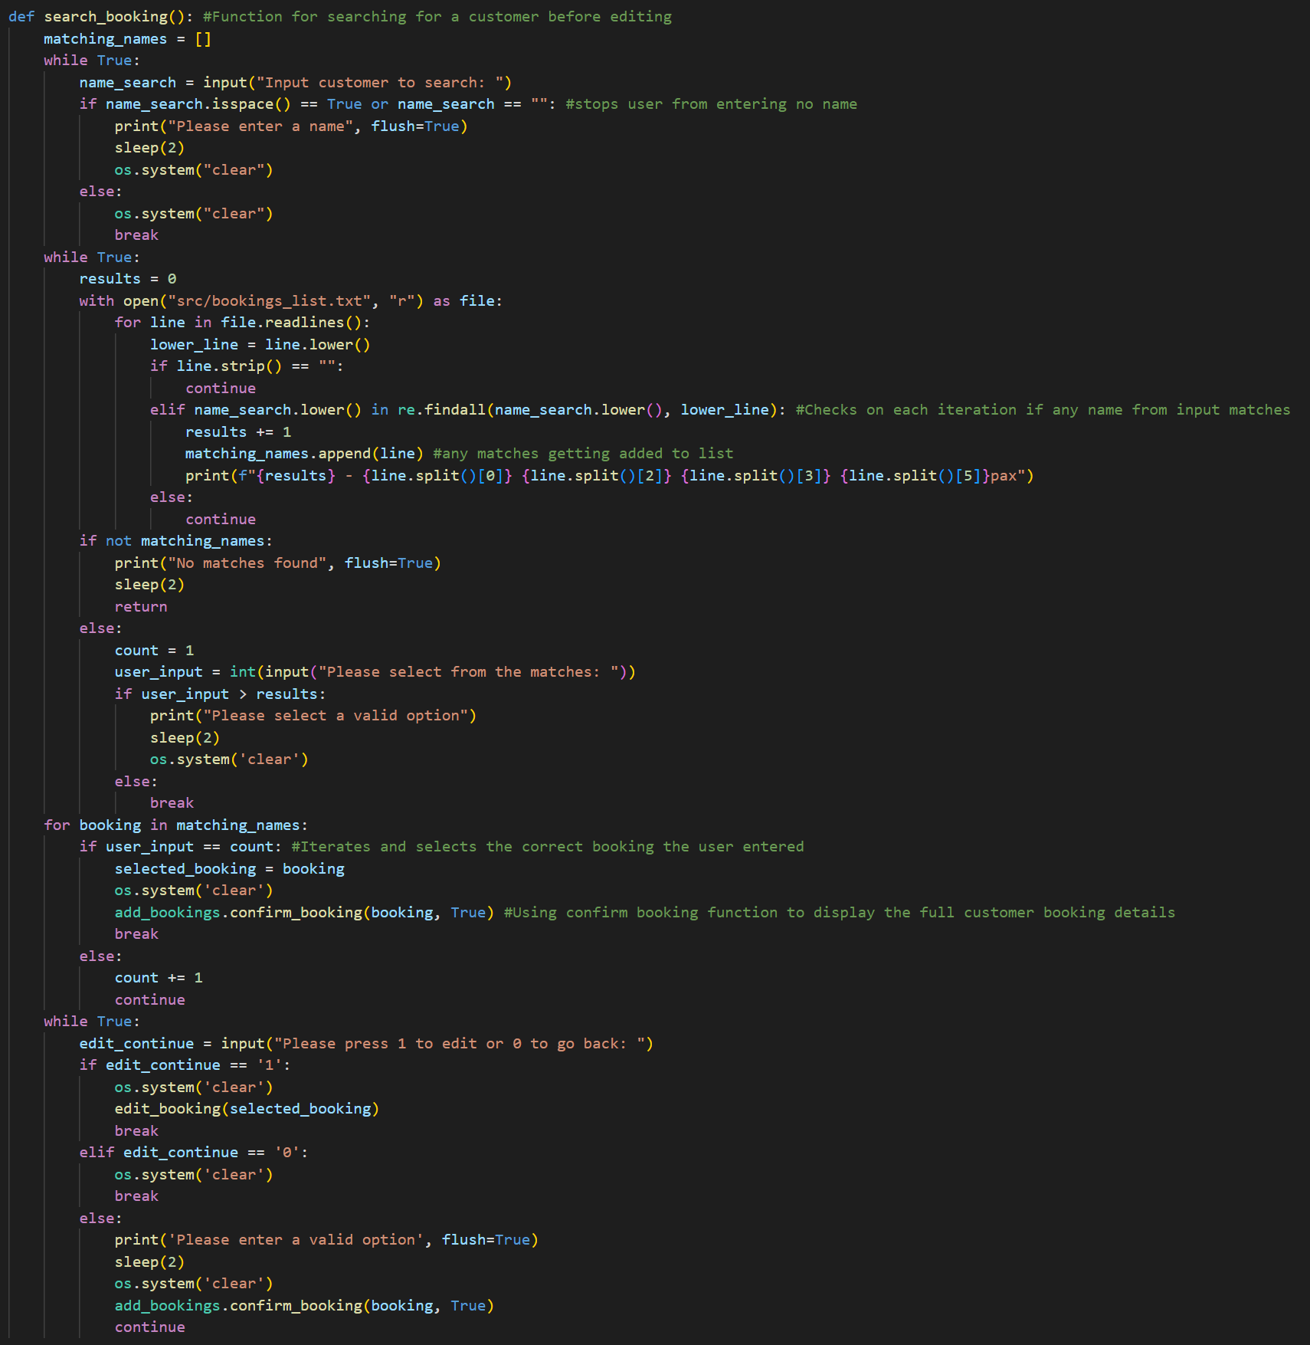
Search booking
From the home page, the user can navigate to ‘search_booking()’ and input a name to search.
The code iterates through the lines and displays results, allowing the user to choose one.
Using the ‘confirm_booking()’ function, the user can view the details before continuing on.

Slide 14
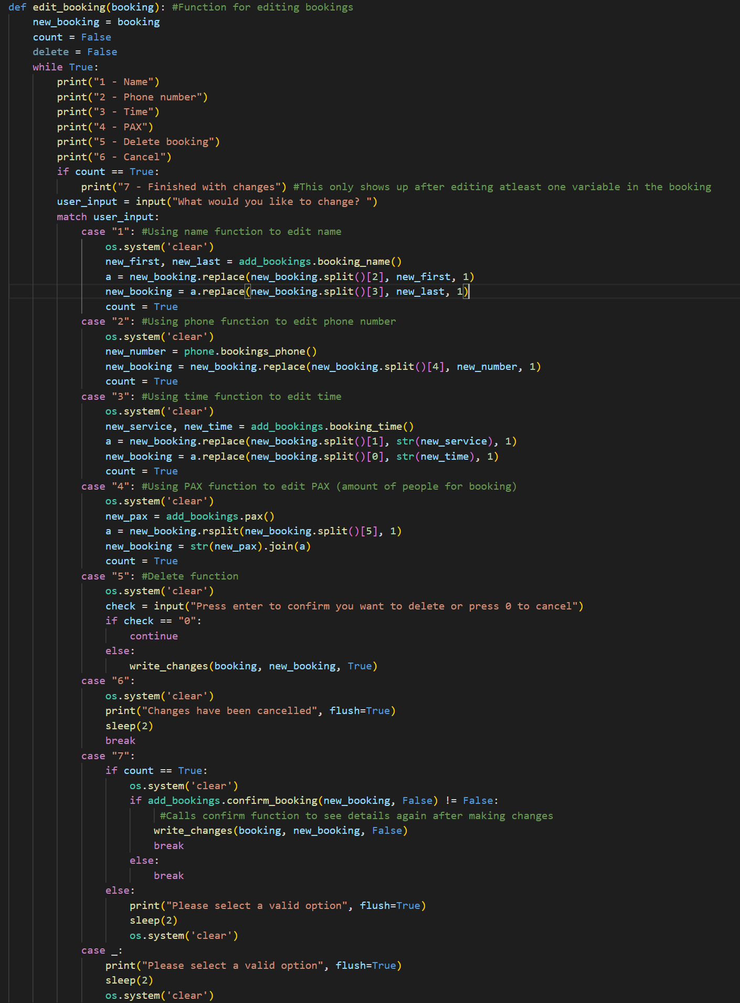
Edit booking
From the ‘search_booking()’ function, the user can edit each detail of the booking. The relevant functions get re used to get the new values and the new values get replaced.
‘confirm_booking()’ function is called again to confirm the new details.

Slide 15
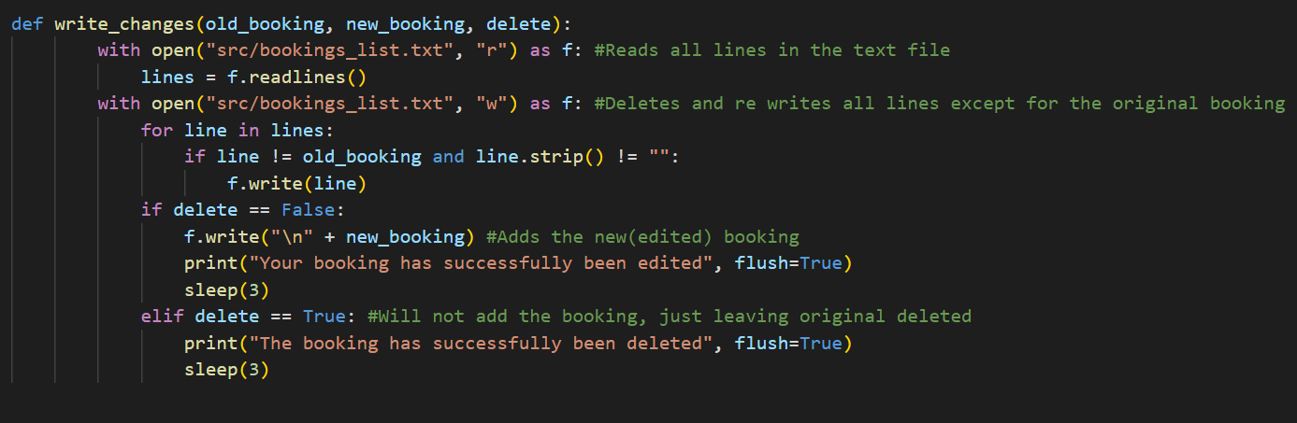
Writing the changes
This function takes in the old booking details and new booking details.
It deletes all the lines and re writes them all in except for the old file.
If the user has selected to just delete the booking, then no new booking will be written at the end.

Slide 16
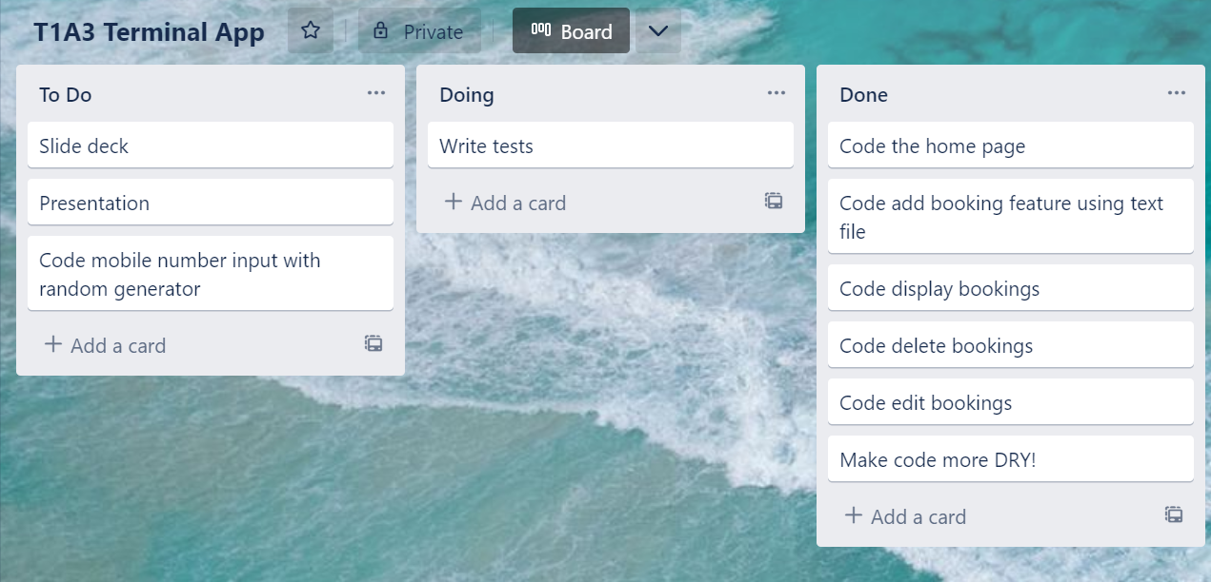
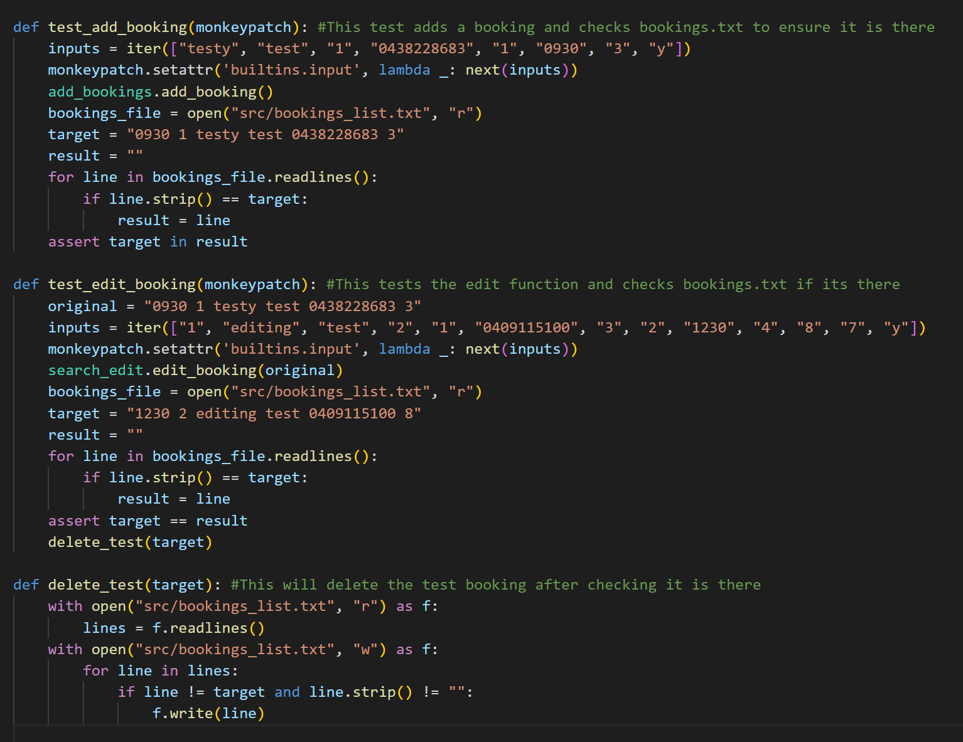
Tests
Using monkeypatch to have the inputs put in, two tests have been written.
First adds a booking in and only passes if it is in the text file.
Second takes the booking from the first test and edits it, passing only if the edit is in the test file.
The test is deleted from the text file at the end.

Slide 17
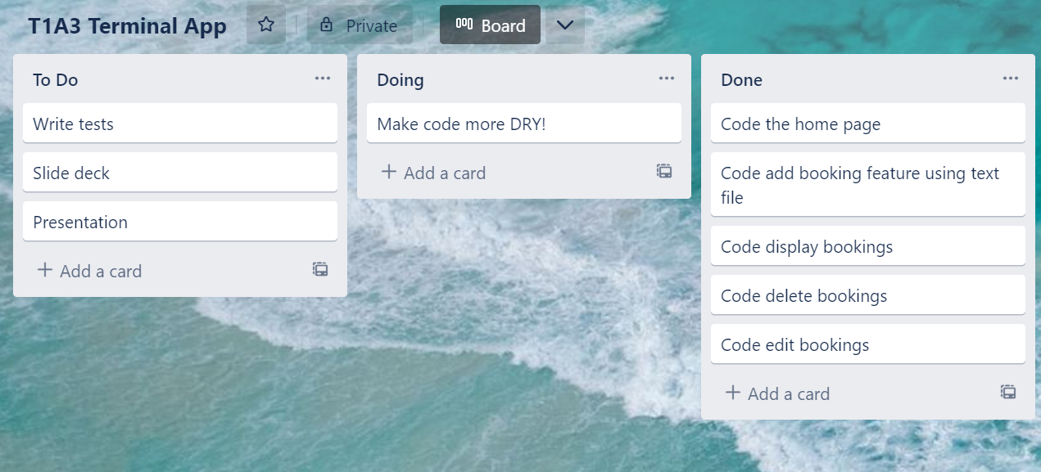
Making the code DRY!
To get my head around getting the structure of the application to work, the code was not DRY to begin with. However when I had the main features in, I looked at the code and made changes where I thought it could be more DRY.

Slide 18
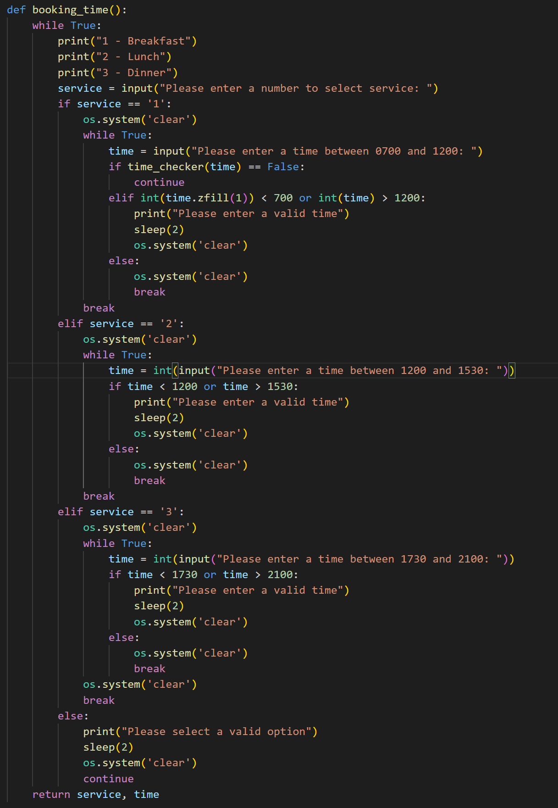
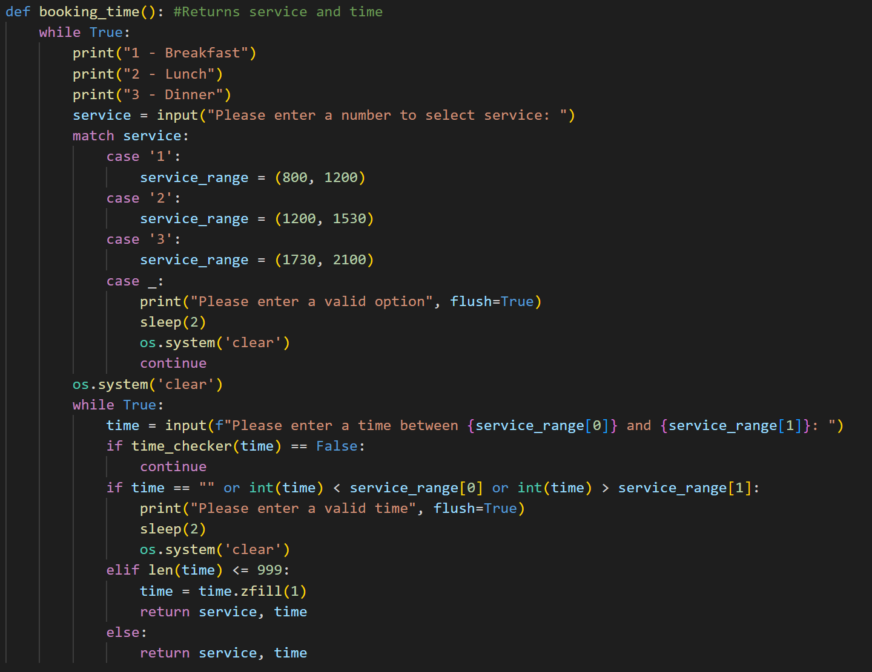
DRY example
My original ‘booking_time()’ function was not DRY at all!
Re designing the function, I was able to half the size in lines, keeping the exact same result.

